Slide 1
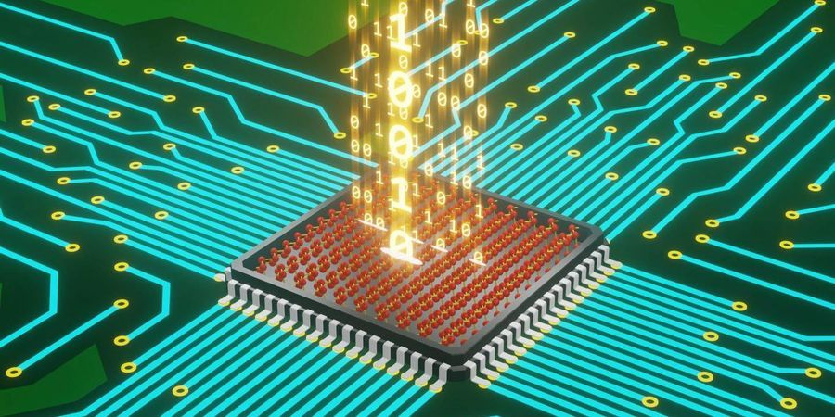
HEALTH MONITORING SYSTEM
LETS MAKE HEALTH TOGETHER …

Slide 2
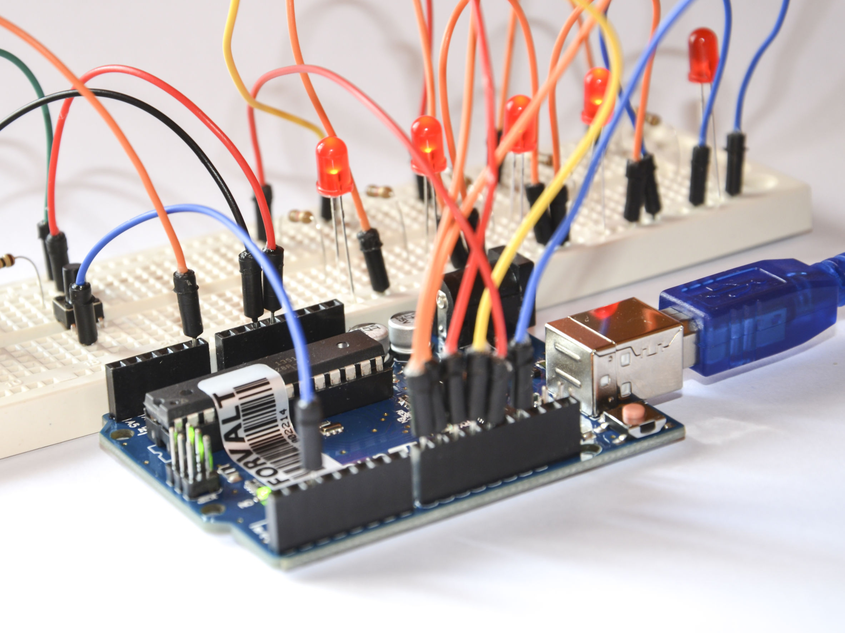
ABSTRACT OVERVIEW
We know the whole world had suffered with problem COVID 19. over 50cr people in the whole world has suffered from this issue of COVID 19.
So in this critical time we have to take care of our health as good as possible.
There is a need of person to help the affected person, who has greater chance of getting affected by virus and he can spread it further.
To rid of this we prepared an IOT based health monitoring system using Arduino MEGA and gsm module, which monitors the patients health on real time.
Not only in this covid situation, this project can also be used for monitoring health status of aged persons and in other conditions.

Slide 3
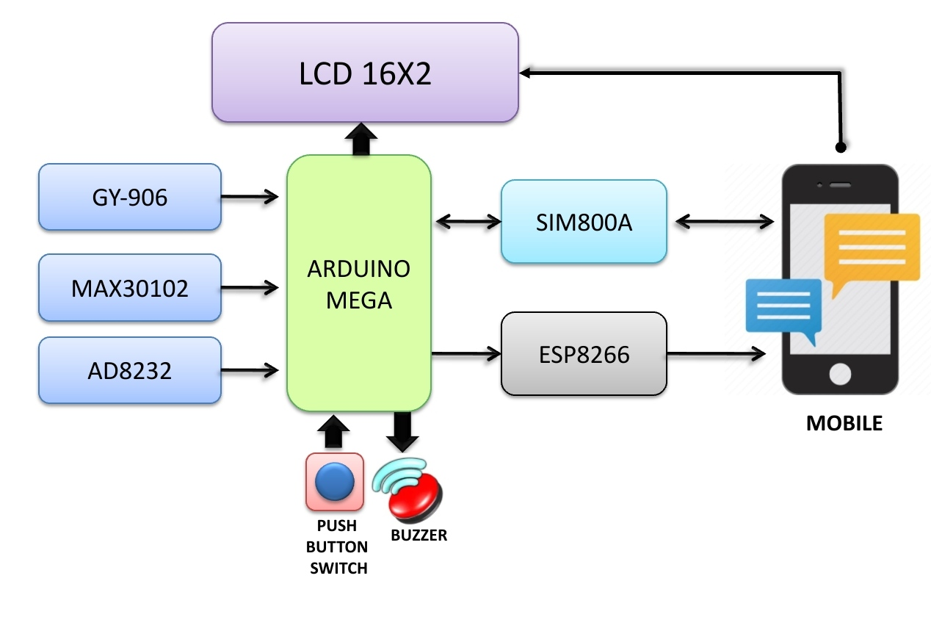
BLOCK DIAGRAM

Slide 4

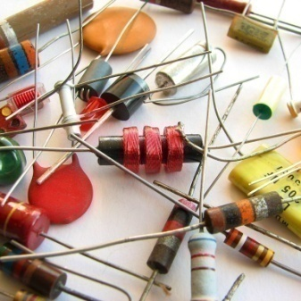
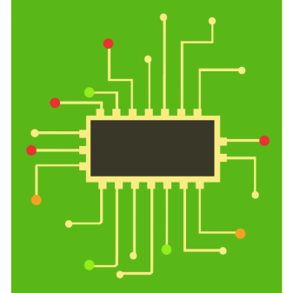




CONTENTS
COMPONENTS
CIRCUIT DIAGRAM
WORKING
ADVANTAGES /
DIS-ADVANTAGES
FUTURE SCOPE
APPLICATIONS

Slide 5



COMPONENTS
ARDUINO MEGA
(Programmable microcontroller unit)
SIM800A
(Gsm Module)
ESP32
(Wifi Module)
MAX30102
(Pulse oximeter module)
AD8232
(ECG sensor module)
GY906
(Temperature sensor module)
LCD 16X2
(Display module)
PUSH BUTTON SWITCH
(Electrical Switch)
BUZZER
(Piezo-electric sounding device)

Slide 6
HARDWARE COMPONENTS

Slide 7
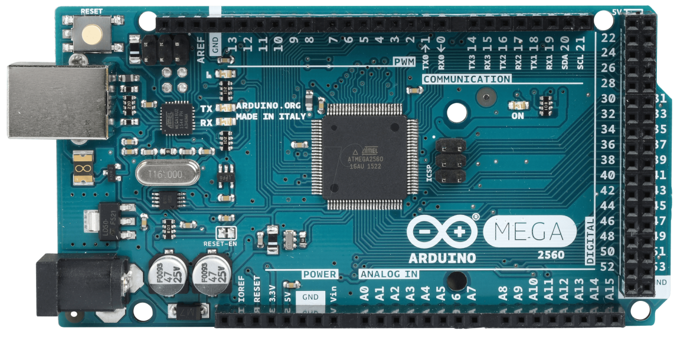
ARDUINO MEGA
DEFINITION:
The Arduino Mega is based on ATmega2560 Microcontroller. The ATmega2560 is an 8-bit microcontroller. We can easily program this microcontroller using arduino software.
SPECIFICATIONS:
Microcontroller | ATmega2560
Operating Voltage | 5 V
Power supply | 7 V – 12 V
Current consumption | 50 mA – 200 mA
Current consumption Deep Sleep | 500 µA
Digital I/O Pins | 54
Digital I/O Pins with PWM | 15
Analog Input Pins | 16
DC Current per I/O Pin | 40 mA
DC Current for 3.3V Pin | 50 mA
Flash Memory | 256 KB
SRAM | 8 KB
EEPROM | 4096 bytes
Clock Speed | 16 MHz
Length | 102 mm
Width | 53 mm
Power jack | yes
USB connection | yes

Slide 8
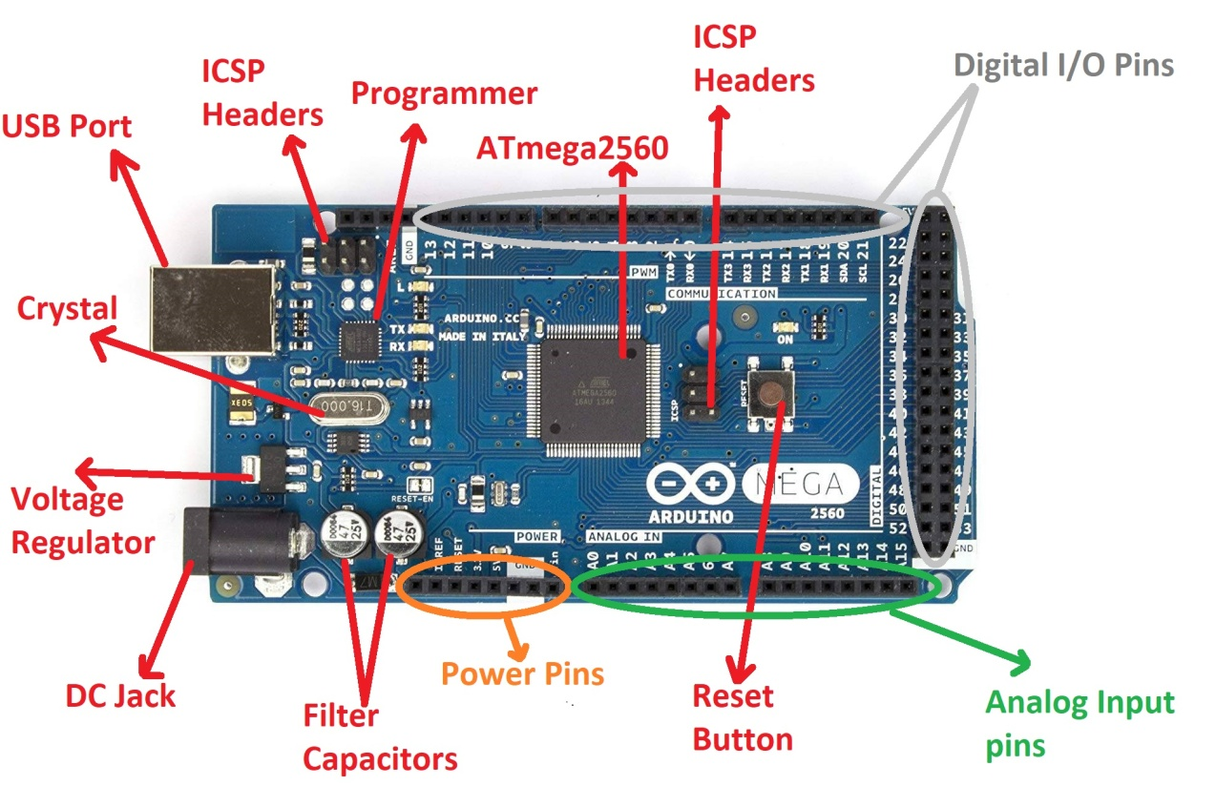
ATmega2560 Microcontroller -
The Atmega2560 is a CMOS (Complementary Metal Oxide Semiconductor) low powered 8-bit microcontroller. The Mega 2560 is based on AVR RISC Architecture. Here, AVR stands for Audio Video Recorder and RISC stands for Reduced Instruction Set Computing.
ARDUINO MEGA PINOUT
GND -
There are 3 Ground Pins in Arduino mega. The ground pins are used to ground the circuit.
USB Port -
It allows the board to connect to the computer. It is essential for the programming of the Arduino Mega board.
We usually plug the USB cable in the USB port to load the sketch to the board.
UART -
It stands for Universal Asynchronous Receiver and Transmitter. It permits the Arduino to communicate with serial devices.
Power Jack -
The power jack is used to supply the power to the board. The adapter is plugged-in to the power jack of the Arduino Mega board.
ICSP Header -
The program or firmware with the advanced functionalities is received by microcontroller with the help of the ICSP (In-Circuit Serial Programming) header.
IOREF -
It stands for Input Output voltage Reference. It allows the shields to check the operating voltage (3.3V or 5V) of the board. The shields are connected to the Arduino Board.
The Microcontroller operates with the reference voltage provided by the IOREF.

Slide 9
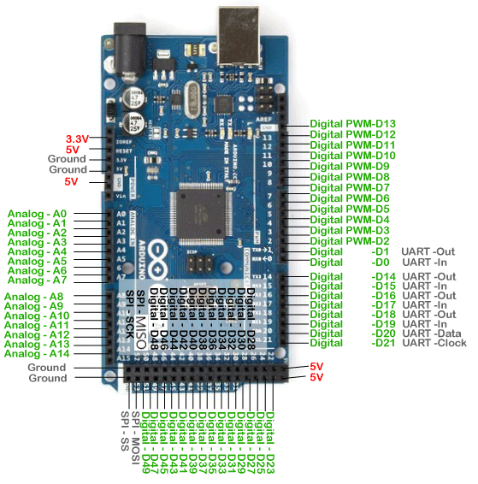
ARDUINO MEGA PINOUT
I2C -
It is the two-wire serial communication protocol. It stands for Inter-Integrated Circuits. The I2C is a serial communication protocol that uses SCL (Serial Clock) and SDA (Serial Data) to receive and send data between two devices. The SCL is a clock line, while SDA is a data line.
Analog pins -
There are total of 16 Analog pins from A0 - A15. The function of Analog pins is to read the analog sensor used in the connection. It can also act as GPIO (General Purpose Input Output) pins.
Digital Pins -
There are 54 digital Input/Output pins from pin numbered from 0 to 53. The 15 pins from the digital I/O are PWM (Pulse Width Modulation) pins numbered from D2 - D13 and D44 - D46. The digital pins have the value either HIGH or LOW.
SPI-SCK -
It stands for Serial Peripheral Interface. It is popularly used by the microcontrollers to communicate with one or more peripheral devices quickly. The SCK stands for serial clock. In slave, it works as the input of the clock generator. In master, it works as the output clock.
5V -
The 5V pin works as the output regulated voltage of 5V.
3.3V -
The 3V3 pin works as the output regulated voltage of 3.3V.
RX and TX -
The successful flow of data is represented by the lighting of the TX and RX LED.
Vin -
It is defined as the input voltage, which is applied to the Arduino Board when it is using an external power source.

Slide 10

WHY MEGA?
ARDUINO UNO
ARDUINO MEGA
Pins: Digital - 14
Analog - 6
Power - 5
MicroController: 8bit Atmega328p
Flash Memory: 32KB
SRAM: 2KB , EEPROM: 1KB
Input: 7-12 V , Output: 5V and 3.3V
Pins: Digital - 54
Analog - 16
Power - 5
MicroController: 8bit Atmega2560
Flash Memory: 256KB
SRAM: 8KB , EEPROM: 4KB
Input: 7-12 V , Output: 5V and 3.3V

Slide 11
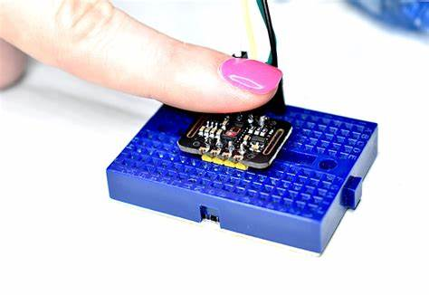
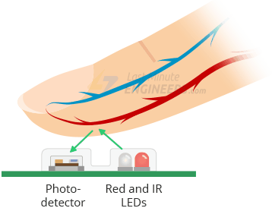
MAX30102
DEFINITION:
The MAX30102 is an integrated pulse oximetry and heart-rate monitor biosensor module based on PPG (Photoplethysmography).
WORKING
The MAX30102 consists of a pair of high-intensity LEDs (RED and IR LED) and a photodetector. The wavelengths of these LEDs are 660nm and 880nm, respectively.
The MAX30102 works by shining both lights onto the finger and measuring the amount of reflected light using a photodetector. This method of pulse detection through light is called Photoplethysmogram.
The working of MAX30102 can be divided into two parts: Heart Rate Measurement and Pulse Oximetry:
Heart Rate Measurement | Pulse Oximetry
The oxygenated hemoglobin (HbO2) in the arterial blood has the characteristic of absorbing IR light. The redder the blood (the higher the hemoglobin), the more IR light is absorbed. As the blood is pumped through the finger with each heartbeat, the amount of reflected light changes, creating a changing waveform at the output of the photodetector. As you continue to shine light and take photodetector readings, you quickly start to get a heart-beat (HR) pulse reading. | Pulse oximetry is based on the principle that the amount of RED and IR light absorbed varies depending on the amount of oxygen in your blood. The following graph is the absorption-spectrum of oxygenated hemoglobin (HbO2) and deoxygenated hemoglobin (Hb).

Slide 12
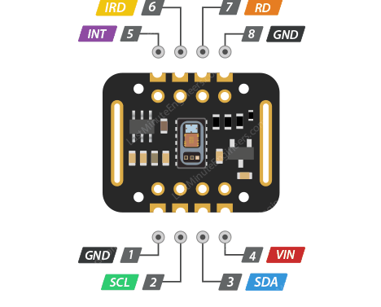
MAX30102 PINOUT
IRD
The MAX30102 integrates an LED driver to drive LED pulses for SpO2 and HR measurements. Use this if you want to drive the IR LED yourself, otherwise leave it unconnected.
INT
The MAX30102 can be programmed to generate an interrupt for each pulse. This line is open-drain, so it is pulled HIGH by the onboard resistor. When an interrupt occurs the INT pin goes LOW and stays LOW until the interrupt is cleared.
SCL
It is the I2C clock pin, connect to your Arduino’s I2C clock line.
GND
It is the ground pin. Which you can connect it to ground pin of Arduino board.
VIN
VIN is the power pin. You can connect it to 3.3V or 5V output from your Arduino.
RD
This pin is similar to the IRD pin, but is used to drive the Red LED. If you don’t want to drive the red LED yourself, leave it unconnected.
Power supply | 1.8V to 3.3V
Current draw | ~600μA (during measurements)
 | ~0.7μA (during standby mode)
Red LED Wavelength | 660nm
IR LED Wavelength | 880nm
Temperature Range | -40˚C to +85˚C
Temperature Accuracy | ±1˚C
SDA
It is the I2C data pin, connect to your Arduino’s I2C data line.
GND
It is the ground pin of max30102 which you can connect it to Arduino’s ground pin.

Slide 13
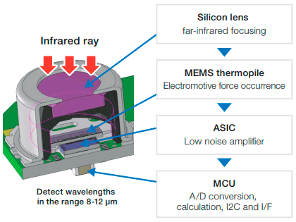
GY906
DEFINITION:
The GY-906 MLX90614 is a high precision infrared non-contact thermometer module with I2C interface and 5V or 3.3V operation.
WORKING
In our world every living being which contains heat dissipates infrared rays.
This sensor will attract that rays and focusses on the thermopile.
Thermopile converts the temperature to voltage levels and it amplifies and gives to MCU.
It used to make sensor compatible with I2C interface and it makes A/D conversion.
At the output we will get the temperature reading without touch.

Slide 14
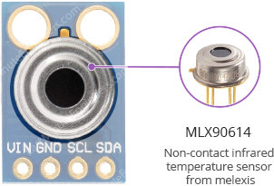
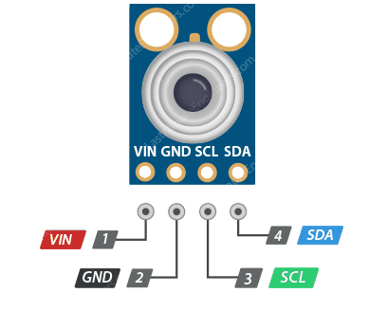
GY906 PINOUT
VIN
It is power pin. You can connect it to 3.3v or 5v output from your Arduino.
GND
It is ground pin. You can connect it to ground pin of Arduino.
SDA
It is the I2C data pin, connect to your Arduino’s I2C data line
SCL
It is the I2C clock pin, connect to your Arduino’s I2C clock line
FEATURES
Non-contact measurement perfect for measuring temperature of moving objects
It is a 4 pin sensor
Range for ambient temperature: -40 to 125 ˚C
Range for object temperature (non contact): -70 to 380 ˚C
Compatible with I2C/SM Bus interface
Operating voltage: 3.3V or 5V

Slide 15
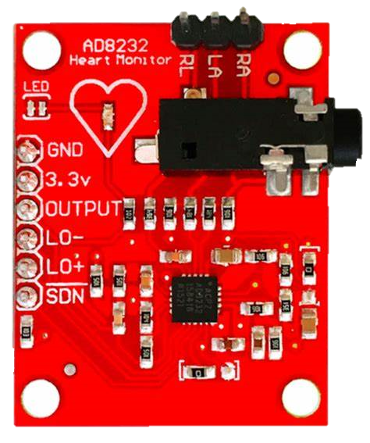
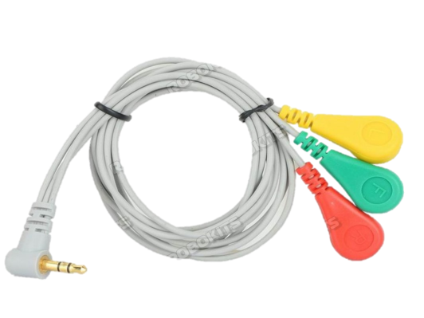
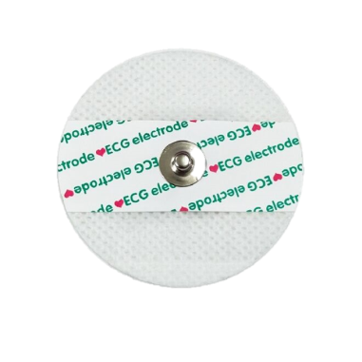
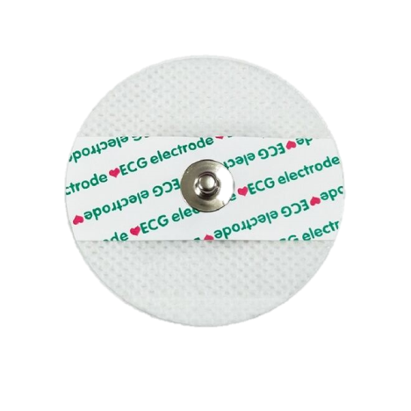

AD8232
DEFINITION:
The AD8232 is a very useful sensor that measures the heart's electrical activity, Known as ECG. ECG, also known as EKG or Electrocardiography, is measuring electrical changes generated by cardiac movement.
The AD8232 single lead ECG heart rate sensor converts heartbeat into an analog signal.
AD8232 is a cost-effective ECG analog sensor for measuring the electrical activity of the heart.
WORKING
AD8232 ECG Module integrated with AD8232 IC from Analog Devices, which is a single-chip designed to extract, amplify, and filter biopotential signals for biopotential measurement applications (like ECG and others). ECGs can be extremely noisy so that the AD8232 Single Lead Heart Rate Monitor acts as an op-amp to help obtain a clear signal from the PR and QT Intervals easily.

Slide 16
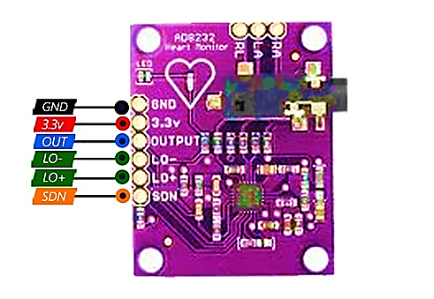
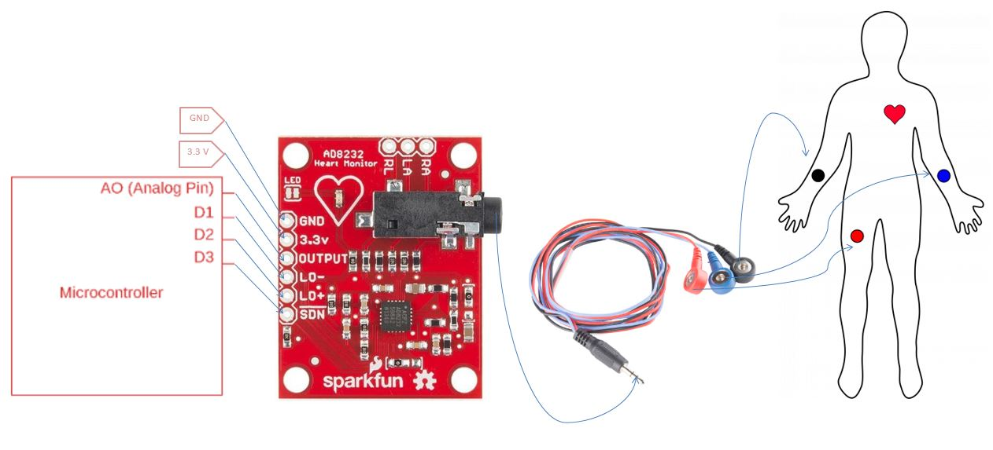
AD8232 PINOUT
SDN
It is power pin. You can connect it to 3.3v or 5v output from your Arduino.
OUT
It is Output pin. You can connect it to analog pin of Arduino to get the ecg readings at output.
LO+
Leads Off Comparator Output. In dc leads off detection mode, LOD+ is high when the +IN electrode is disconnected, and it is low when connected
LO-
Leads Off Comparator Output. In dc leads off detection mode, LO− is high when the electrode to −IN is disconnected, and it is low when connected
VIN
It is power pin. You can connect it to 3.3v output from your Arduino.
GND
It is ground pin. You can connect it to ground pin of Arduino.
SPECIFICATIONS:
Analog type output
Operating voltage: 3.3V DC
Low current consumption: 170 uA
Noise rejection at 60Hz: 80dB
High gain (G = 100), with DC current blocking
Integrated Right Leg Amplifier (RLD)
Shutdown pin, Leads-Off Detection
Electrode input: Mini Plug 3.5mm
Configurations: 2 or 3 electrodes

Slide 17
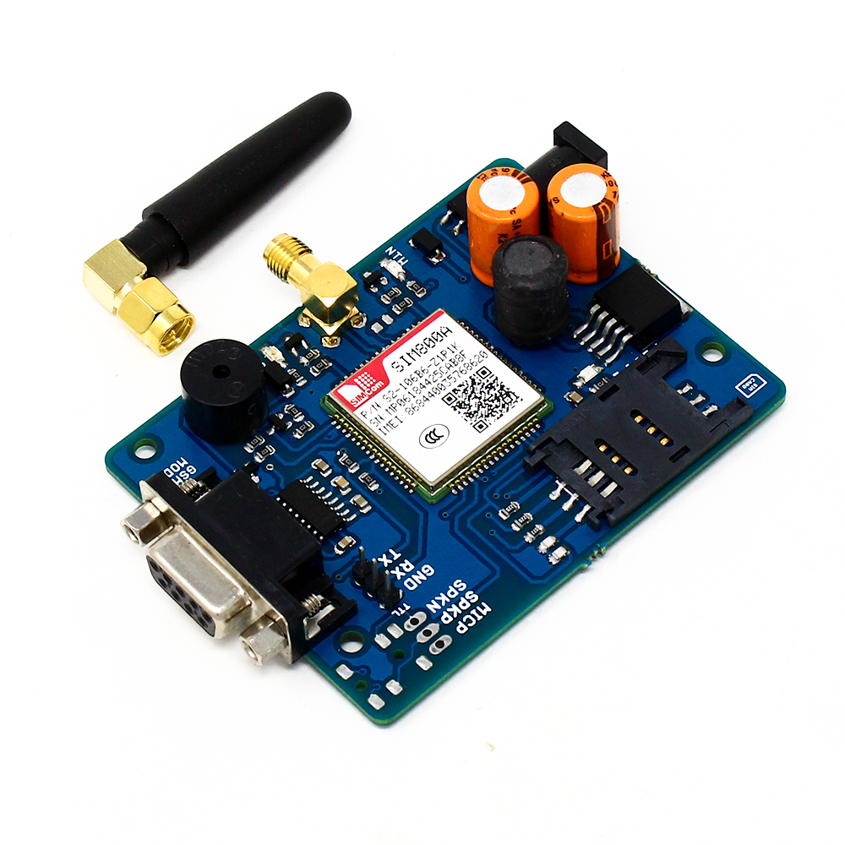
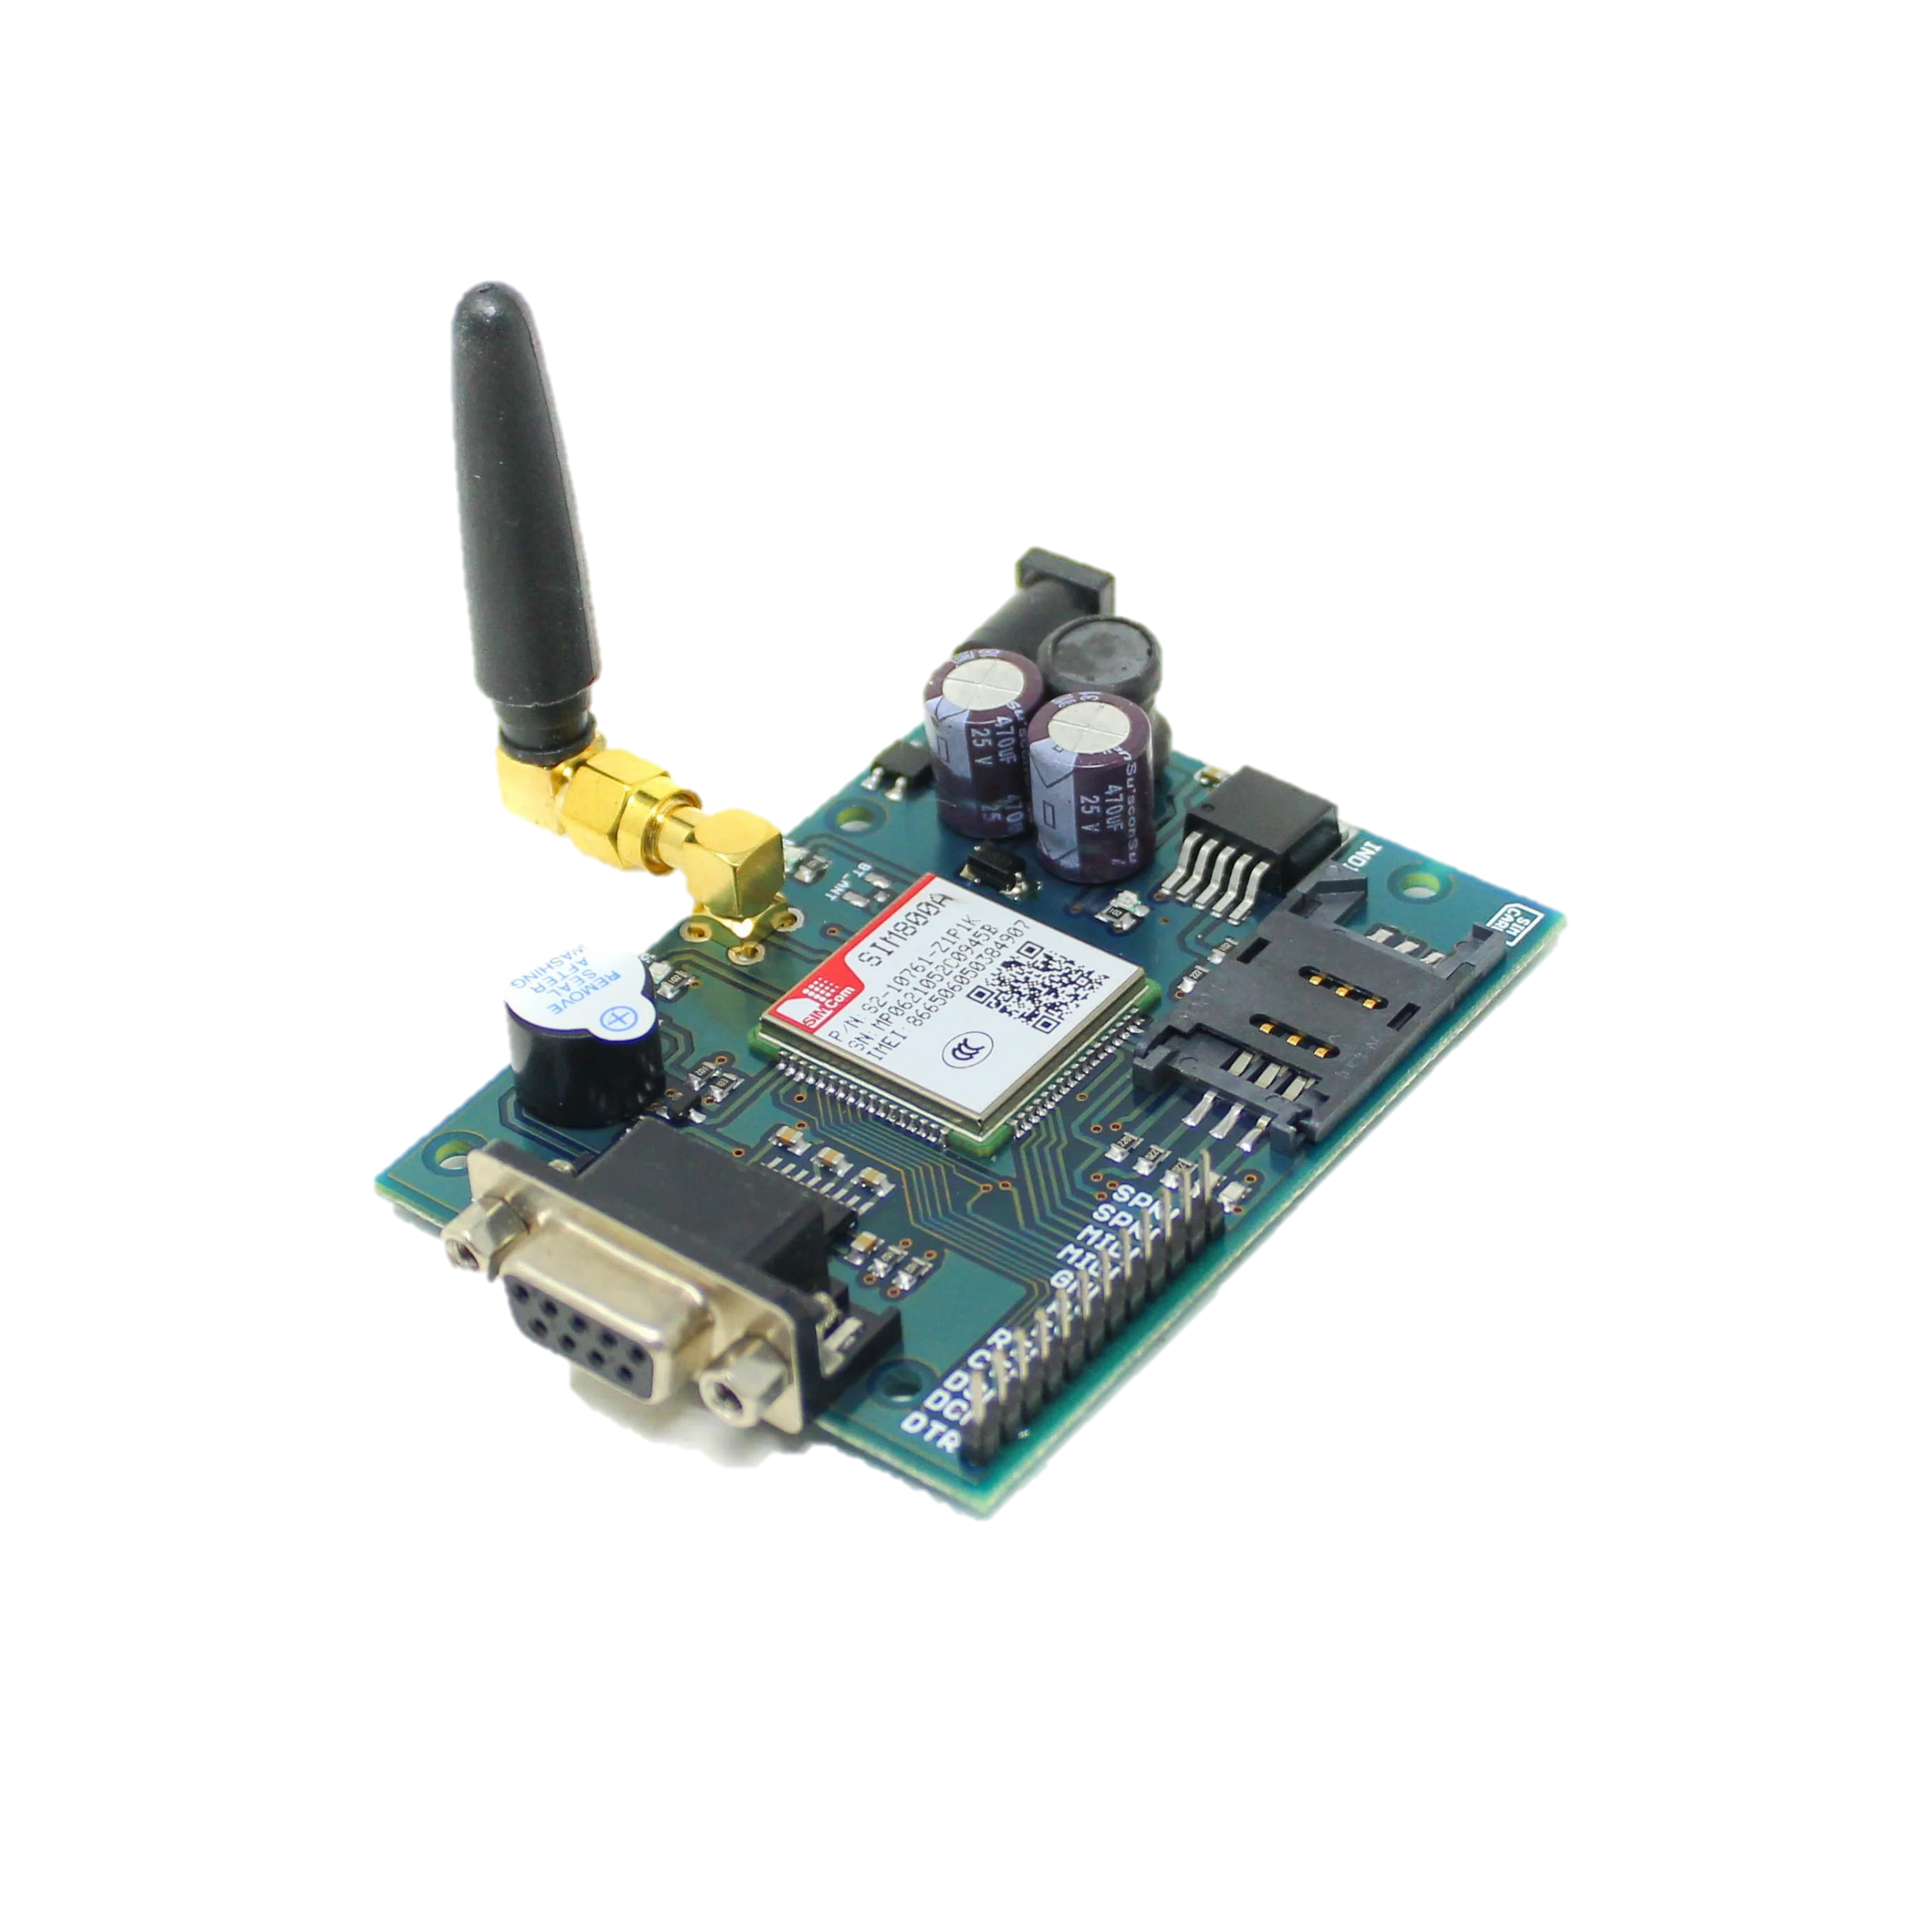
SIM800A
DEFINITION:
A GSM module or a GPRS module is a chip or circuit that will be used to establish communication between a mobile device or a computing machine or a GSM system.
it can transmit Voice, SMS, and data information with low power consumption. It requires a SIM card to activate communication with the network. Also they have IMEI number for their identification.
FUNCTIONS:
Read, write and delete SMS messages.
Send SMS messages.
Monitor the signal strength.
Monitor the charging status and charge level of the battery.
Read, write and search phone book entries.
Make, Receive, or reject a voice call.

Slide 18
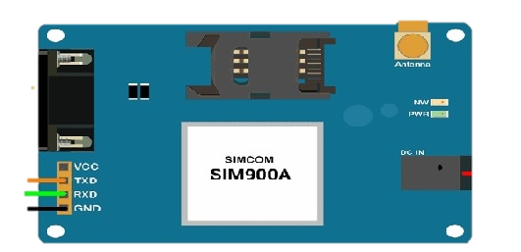
SIM800A PINOUT
TXD
The txd pin used to transmit the serial data
RXD
The Rxd pin used to receive the serial data
VCC
It is power pin. You can connect it to 3.3v or 5v output from your Arduino.
GND
It is ground pin. You can connect it to ground pin of Arduino.
Features:
Bands: GSM 850MHz, EGSM 900MHz, PCS 1900MHz
SIM800A Quad Band GSM Module
Control via AT commands.
Voltage Supply Required- 9VDC to 12VDC with atleast 2A Peak Current Capability
Built-in SIM Card holder.
Built-in Network Status LED.
Inbuilt Powerful TCP/IP protocol stack for internet data transfer over GPRS.
Low power.
Operating temperature: -40C to +85C
External Finger type antenna
SIM800A

Slide 19
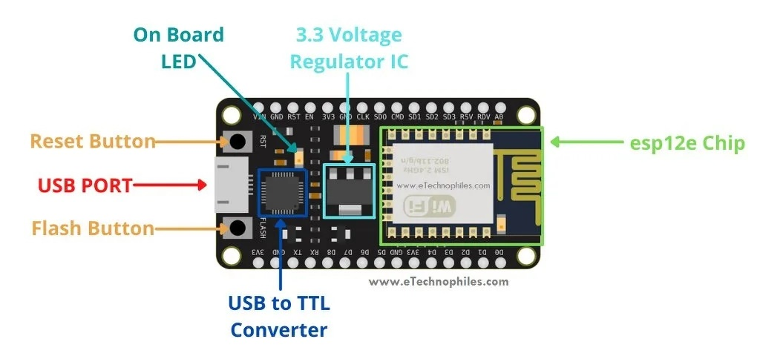
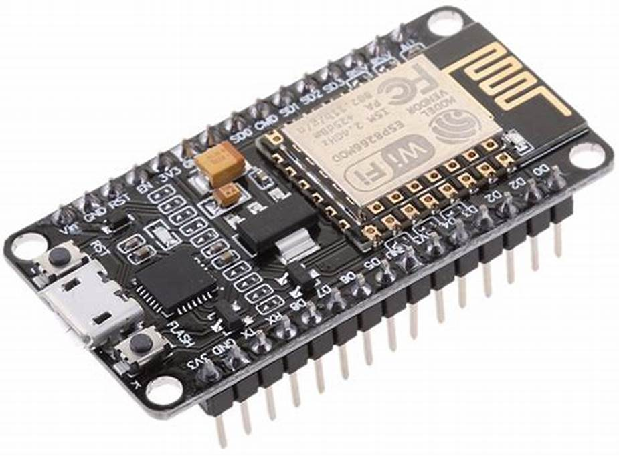
ESP8266
Microcontroller | ESP-8266 32-bit
Clock Speed | 80-160 MHz
USB Connector | Micro USB
Operating Voltage | 3.3V
Input Voltage | 4.5V-10V
Flash Memory / SRAM | 4 MB / 128 KB
GPIO Pins | 17
Digital I/O Pins | 11
Analog In Pins | 1
PWM Pins | 4
ADC Range | 0 - 3.3V
UART / SPI / I2C | 2 / 1 / 1
WiFi Built-In | 802.11 b/g/n
Temperature Range | -40C – 125C
DEFINITION:
NodeMCU is an open-source Lua based firmware and development board specially targeted for IoT based Applications. It includes firmware that runs on the ESP8266 Wi-Fi SoC from Espressif Systems, and hardware which is based on the ESP-12 module.

Slide 20
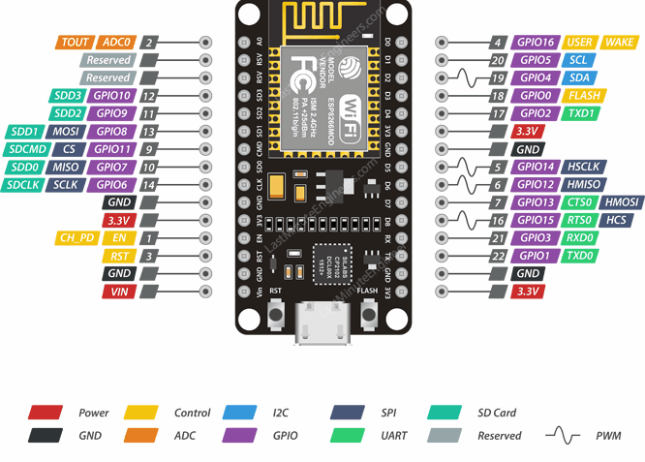
ESP8266 PINOUT
GPIO
It has 17 GPIO pins which can be assigned to various functions such as I2C, I2S, UART, PWM, IR Remote Control, LED Light and Button programmatically.
POWER PINS
There are four power pins - one VIN pin & three 3.3V pins. The VIN pin can be used to directly supply the ESP8266 and its peripherals,. The 3.3V pins are the output of an on-board voltage regulator. These pins can be used to supply power to external components.
ADC
ESP8266 has an inbuilt 10-bit ADC. In other words, the board has only one analog pin to read the analog voltage values from external devices like sensors and potentiometers.
UART
NodeMCU has two UART interfaces, UART0 (RXD0 & TXD0) and UART1 (RXD1 & TXD1). UART1 is used to upload the firmware/program.
SPI
ESP8266 has 4 SPI pins:
MOSI, MISO, SCLK, and CS.
SDIO
ESP8266 features Secure Digital Input/Output Interface (SDIO) which is used to directly interface SD cards.
PWM
The board has 4 PWM pins. The PWM output can be implemented programmatically and used for driving digital motors and LEDs
CONTROL PINS
There are 3 control pins are there i.e.
EN pin , RST pin, WAKE pin

Slide 21
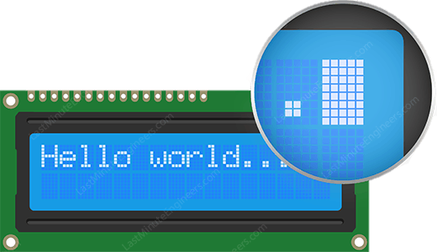
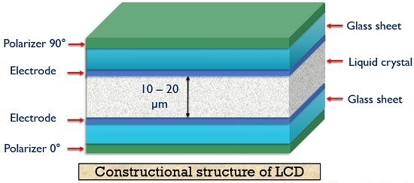
LCD 16X2
DEFINITION:
LCD is an acronym used for Liquid Crystal Display. It is basically a display technique in which liquid crystals are used in order to produce an image on the screen.
CONSTRUCTION
The liquid crystal having a thickness of nearly about 10 to 20 micrometers is placed between two glass sheets. On the inner surface of the two glass sheets, conductors are inserted. These conductors form electrodes. The two electrodes show positive and negative polarity to be applied. The external potential is provided to the display unit with the help of these two electrodes. These are basically formed by materials like indium oxide (IN₂O₃) and stannic oxide (SnO₃).
Here, a fluorescent light source is used. The light emitted by this source is then fed to the polarizer here we have considered a vertical polarizer as the input polarizer. Also, a polarizer of opposite polarity as that of input is placed at another end of the display unit. So, here if we have assumed vertical polarizer as the input polarizer then at the other end it must be a horizontal polarizer. At the opposite end of the electrode, a glass cover is placed at which the desired image is displayed.

Slide 22
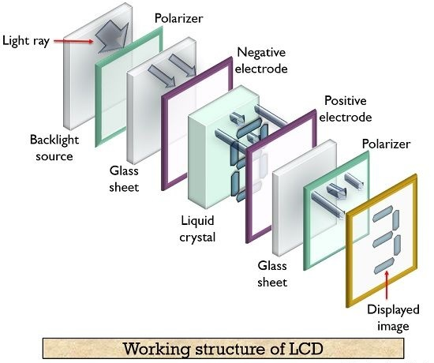
LCD 16X2
WORKING
The basic working principle of LCD is blocking of light. It does not produce light on its own. So external light source is used. When the external light passes from one polarizer to the next polarizer, external supply is given to the liquid crystal ,the polarized light aligns itself so that the image is produced in the screen.
The indium oxide conducting surface is a transparent layer which is placed on both the sides of the sealed thick layer of liquid crystal . When no external bias is applied the molecular arrangement is not disturbed.
When the external bias is applied the molecular arrangement is disturbed and it and that area looks dark and the other area looks clear.
In the segment arrangement, the conducting segment looks dark and the other segment looks clear. To display number 2 , the segments A,B,G,E,D are energized.

Slide 23
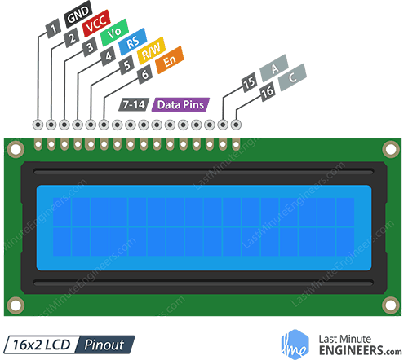
LCD16X2 PINOUT
GND
This is ground pin of LCD. It should be connect to ground pin of Arduino
VCC
This is power pin of LCD. It should be connect to 5v pin of Arduino
VDD
It controls the contrast and brightness of the LCD. Using a simple voltage divider with a potentiometer, we can make fine adjustments to the contrast.
RS
This pin lets the Arduino tell the LCD whether it is sending commands or the data. Basically this pin is used to differentiate commands from the data. RS value will be Low to send commands & High to send characters/data
R/W
This pin on the LCD is to control whether or not you’re reading data from the LCD or writing data to the LCD. Since we’re just using this LCD as an OUTPUT device, we’re going to tie this pin LOW. This forces it into the WRITE mode.
ENABLE
This pin is used to enable the display. Meaning, when this pin is set to LOW, the LCD does not care what is happening with R/W, RS, and the data bus lines; when this pin is set to HIGH, the LCD is processing the incoming data.
DATA PINS
These pins that carries the 8 bit data we send to the display.
For example, if we want to see the uppercase ‘A’ character on the display we will set these pins to 0100 0001 to the LCD.
A & K
These pins are used to control the backlight of the LCD.

Slide 24
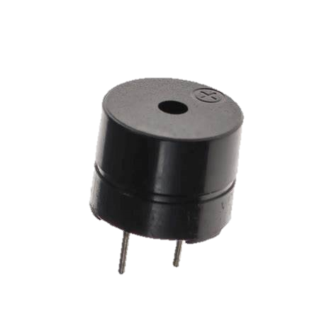
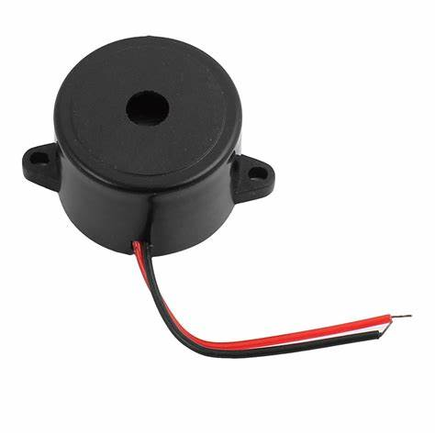
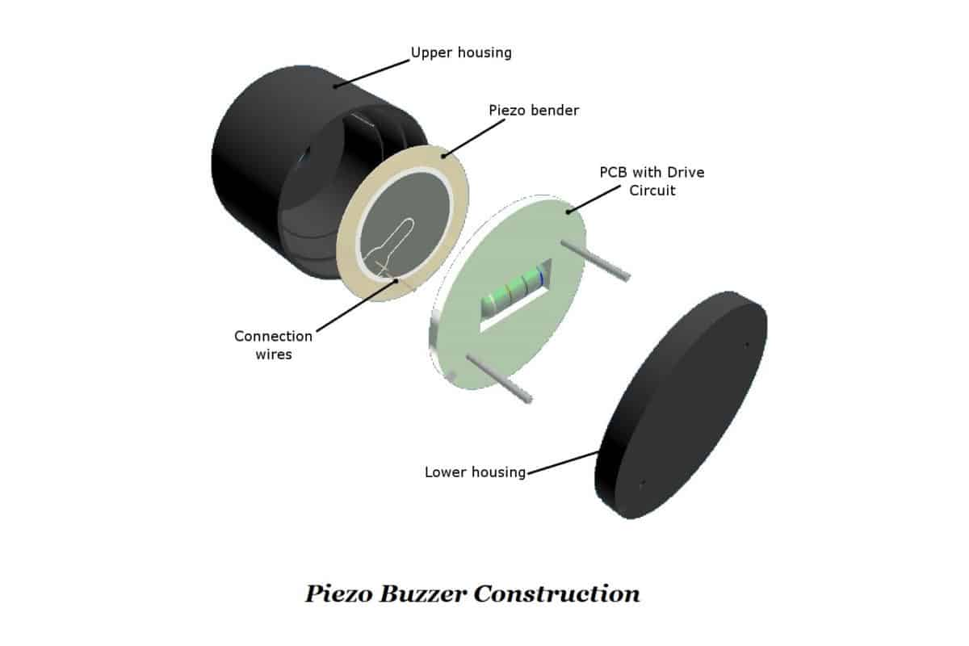
BUZZER
DEFINITION:
A piezo buzzer is a type of electronic device that’s used to produce a tone, alarm or sound. It’s lightweight with a simple construction, and it’s typically a low-cost product.
CONSTRUCTION
The heart of all piezo-type buzzers is the piezoelectric element. The piezoelectric element is composed of a piezoelectric ceramic and a metal plate held together with adhesive. Both sides of the piezoelectric ceramic plate contain an electrode for electrical conduction. Piezo materials exhibit a specific phenomenon known as the piezoelectric effect and the reverse piezoelectric effect. Exposure to mechanical strain will cause the material to develop an electric field, and vice versa.

Slide 25
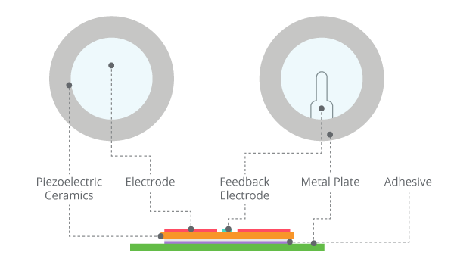
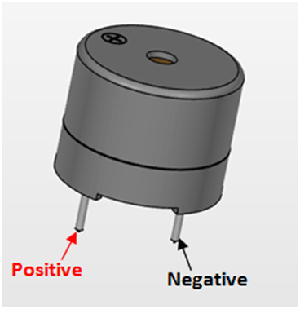
BUZZER
WORKING
When a small DC voltage is applied to the input pins, it is first converted to an oscillating signal using the combination of resistor and transistor. These oscillating signals are amplified using the inductor coil. When high voltage alternating signals are applied to the piezo ceramic disc, it causes mechanical expansion and contraction in radial direction. This causes the metal plate to bend in opposite direction. When metal plate bends and shrinks in opposite direction continuously it produces sound waves in the air.
SPECIFICATIONS:
Rated Voltage: 6V DC
Operating Voltage: 4-8V DC
Rated current: <30mA
Sound Type: Continuous Beep
Resonant Frequency: ~2300 Hz
Small and neat sealed package
Breadboard and Perf board friendly

Slide 26
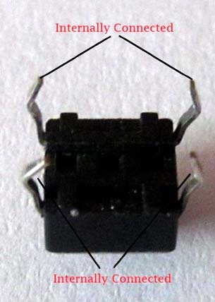
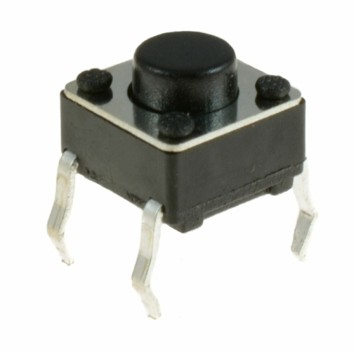
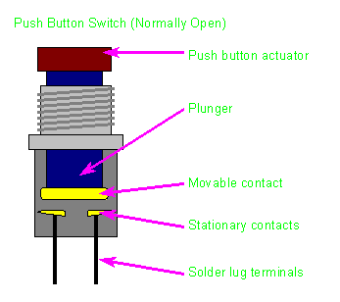
PUSH BUTTON SWITCH
DEFINITION:
Push buttons switch is small, sealed Mechanism that used to complete an electric circuit when you press on it.
CONSTRUCTION
The push button has 4 main parts i.e. push button actuator, spring(plunger), movable contact, stationary contacts, terminals.
The actuator is used to push in or push out
Spring is used to store the mechanical energy, in push button switch it gives the springy effects
A conductor used to make contact between 2 electrodes i.e. terminals of switch
Whenever we push the actuator, using spring the movable contact make short to the 2 terminals

Slide 27
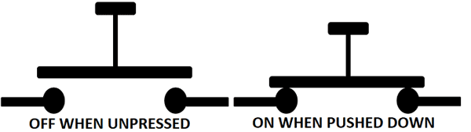
PUSH BUTTON SWITCH
WORKING
Push Buttons are normally-open tactile switches. Push buttons allow us to power the circuit or make any particular connection only when we press the button. Simply, it makes the circuit connected when pressed and breaks when released. These are the most common buttons which we see in our daily life electronic equipment’s.
SPECIFICATIONS:
Mode of Operation: Tactile feedback
Power Rating: MAX 50mA 24V DC
Insulation Resistance: 100Mohm at 100v
Operating Force: 2.55±0.69 N
Contact Resistance: MAX 100mOhm
Operating Temperature Range: -20 to +70 ℃
Storage Temperature Range: -20 to +70 ℃

Slide 28

SOFTWARE COMPONENTS:
SOFTWARE TOOLS
ARDUINO (IDE) | UBIDOTS (WEBSITE)
To write and dump the arduino sketch to arduino board | To Display the accurate readings on website

Slide 29

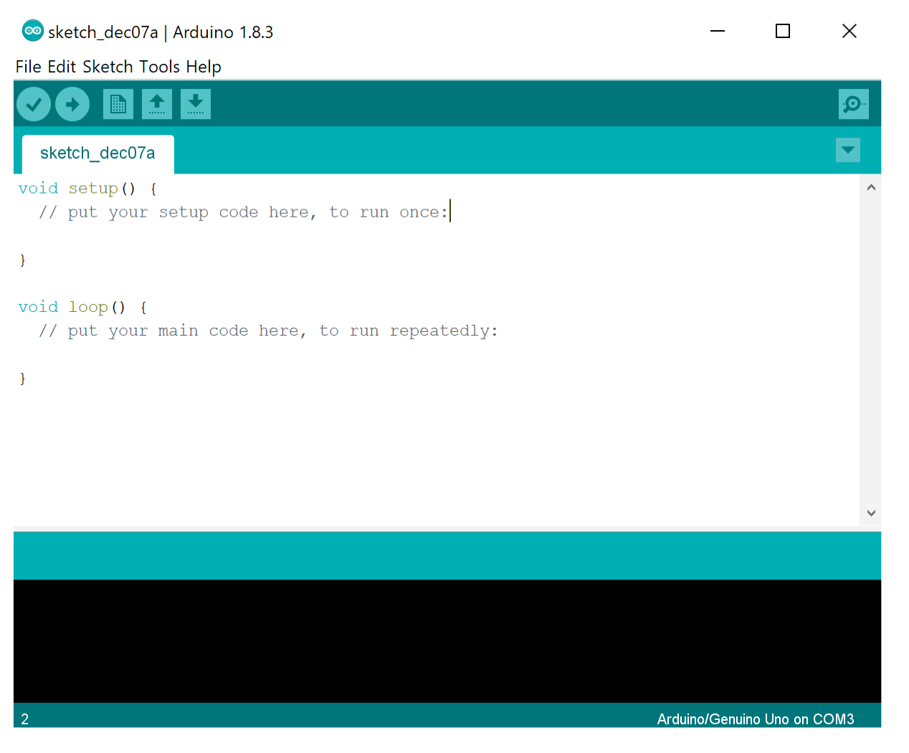
Primarily we have to DOWNLOAD ARDUINO IDE from the official site
ARDUINO IDE
The open-source Arduino Software (IDE) makes it easy to write code and upload it to the board. This software can be used with any Arduino board.

Slide 30
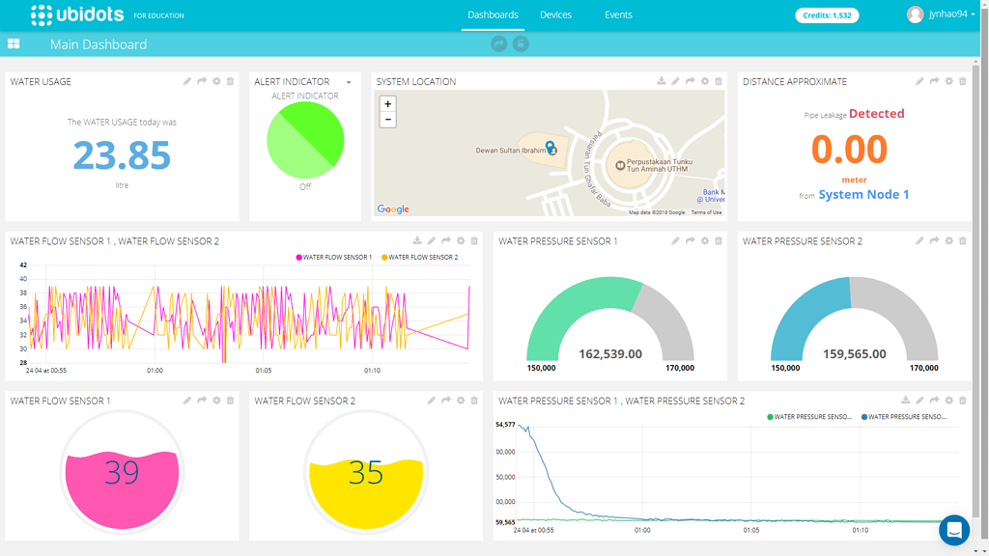
UBIDOTS WEBSITE
Ubidots allows you to aggregate, visualize and analyze live data streams in the cloud.
Some of the key capabilities of ubidots include the ability to:
Easily configure devices to send data to ubidots using popular IoT protocols.
Visualize your sensor data in real-time.
Aggregate data on-demand from third-party sources.
Run your IoT analytics automatically based on schedules or events.
Prototype and build IoT systems without setting up servers or developing web software.

Slide 31
PROJECT DETAILS

Slide 32

ABOUT PROJECT:
A Health Monitoring System (HMS) is a sophisticated technology and an alternative to the traditional management of patients and their health. It consists of a set of sensors that are paired with an application for a doctor to access the medical information.
Real-time health monitoring devices provide real-time analysis of the patients health parameters. Patients are sharing their healthcare information in real time with their caregivers through these devices for flexible health monitoring and management. Internet of medical things is vastly improving the healthcare condition of patients.
In our project we are measuring the health readings like ECG readings, blood oxygen levels, heart rate and body temperature. Using these values the doctor and caregiver can check the patients health status.
It is IoT based so the readings will be directly sent to doctors mobile and caregivers mobile using it doctor can analyze the patients health and give the correct prescription via SMS.

Slide 33
CIRCUIT DIAGRAM:

Slide 34
PROJECT WORKING:
Lorem text

Slide 35

ADVANTAGES:
Real-time health monitoring systems using IoT can help doctors prioritize patients, and provide urgent care to those who are in the most danger thereby saving lives.
More competent patient management can help utilize the resources of the hospital more wisely and save money.
It is easy to use the system for patients and medical professionals.
The remote health monitoring system is especially useful to monitor patients with chronic diseases. Most chronic diseases are incurable, so it is necessary to monitor the state of the patient while at home, and quickly respond if health indicators worsen.
The Health Monitoring System is convenient and portable so it is very convenient for doctors to manage patients from one website, and it is also very easy for patients to monitor their own health by using this health care system

Slide 36

DIS-ADVANTAGES:
Security and privacy remain a major concern deterring users from using IoT technology for medical purposes, as healthcare monitoring solutions have the potential to be breached or hacked. The leak of sensitive information about the patient’s health and location and meddling with sensor data can have grave consequences, which would counter the benefits of IoT.
Failure or bugs in the hardware or even power failure can impact the performance of sensors and connected equipment placing healthcare operations at risk. In addition, skipping a scheduled software update may be even more hazardous than skipping a doctor check-up.
There’s no consensus regarding IoT protocols and standards, so devices produced by different manufacturers may not work well together. The lack of uniformity prevents full-scale integration of IoT, therefore limiting its potential effectiveness.
While IoT promises to reduce the cost of healthcare in the long-term, the cost of its implementation in hospitals and staff training is quite high.

Slide 37
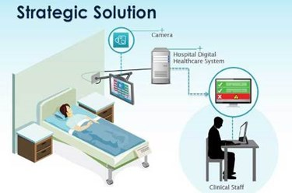
APPLICATIONS:
This automatic wireless health monitoring system could be used in hospitals for knowing the patient body temperature automatically without wasting any time.
By using this system, the patient could be treat timely and save his life.
This system could be also used for heart rate or blood pressure etc. by just adding the appropriate sensors.
By using this system, the man power could be reduced.
This system is more compact, more reliable, less costly and less consume power as compare to the other medical equipment’s.

Slide 38

FUTURE SCOPE
According to a Business Insider report, the market for IoT healthcare technology will rise to $400 billion by 2022. Such growth will be due to the increasing demand, the improvement of 5G connectivity and IoT technology and the growing acceptance of healthcare IT software. The plans of tech giants like Apple, Google and Samsung to invest in bridging the gap between fitness tracking apps and actual medical care are sure to contribute to the process too.
Despite the downsides, further digital transformation in healthcare is inevitable and the concept of IoT will continue to capture and change the landscape of healthcare services. Thus, it seems to be high time to look beyond the challenges and embark on the journey to connected healthcare devices.

Slide 39
Such innovation does not come cheap. However, it is possible to find an affordable way to budget for your health monitoring system project development. The best thing to do is contact a vendor who already has experience with medical projects and can find ways to develop only the features that are must-haves for your medical practice or business.
CONCLUSION

Slide 40

OUR TEAM
T. Rajeev
19253-EC-243
M. Sunny Babu
19253-EC-238
K. PALLAVI
19253-EC-253
N. Karthik
19253-EC-228
U. Sai Kumar
19253-EC-224

Slide 41



THANK YOU!
BATCH-9
GUIDE- Mounika mam

